Slide 1
PERSONAL PORTFOLIO

Slide 2
STUDENT PROFILE
NAME
FEROZKHAN.S
REG NO/NMID
212403850/
0369DFBBFB621A9882349E9379172762
DEPARTMENT
COMPUTER APPLICATION
COLLEGE
TAGORE COLLEGE OF ARTS AND SCIENCE CHROMEPET-44

Slide 3
PROJECT TITLE
PERSONAL PORTFOLIO

Slide 4
AGENGA
1. Problem Statement
2. Project Overview
3. End User
4. Tools And Technologies
5. Portfolio Design And Layout
6. Features And Functionality
7. Result And Screenshot
8. Conclusion
9. Github Link

Slide 5
PROJECT OVERVIEW
This Project Is A Personal Portfolio Website For Feroz , Focusing On Presenting Core Skills, Specializations, Completed Bootcamps, And A Mechanism For Visitors To Get In Touch.
It Aims To Provide Clarity For Potential Collaborators And Employers.

Slide 6
WHO ARE THE END USER?
1. Recruiters Searching For Beginner Front-enddevelopers And Ul/UX Designers.
2. Collaborative Professionals Within The Designand Development Ecosystem.
3. Anyone Interested In Viewing The Designer'swork And Journey.

Slide 7
TOOLS AND TECHNOLOGIES
1. VS Code (For Editing And Managing Code).
2. HTML, CSS, And Javascript (For Building The Interface And Interactions)
3. Figma (Tool For UI/UX And Asset Design).
4. Optionally, React. Js Or Similar JS Libraries Can Be Used For Modular Components And Dynamic Content (Not Shown Explicitly But Can Be Derived From Best Practices).

Slide 8
PORTFOLIO DESIGN AND LAYOUT
1. Header Featuring The Portfolio Owner's Name And Navigation Links (About, Portfolio, Contact)
2. Hero Section Introduces Feroz With A Catchy Greeting, Skills Summary, And A Call-to-action Button.
3. About Me Section Showcasing The Developer's Backgroundand Growth Ambitions.
4. Skills Journey Uses Progress Circles To Visually Represent Proficiency In Ui/Ux, Figma, And Java.
5. Specializations Section Lists Successfully Completed bootcamps With A Modern Card Layout.
6. Contact Form Allows Visitors To Easily Connect Using Name, Email, And Message Inputs.
7. Clean And Minimal Dark-themed Aesthetic, With Accent Blue Highlights.

Slide 9
FEATURES AND FUNCTIONALITY
1. Navigation Bar For Quick Access To Core Sections.
2. Responsive Layout For Optimal Display Across Devices.
3. Interactive Skill Indicators (Percent-based Circles).
4. Showcase Of Completed Bootcamps (Javascript, Figma).
5. Contact Form With Basic Validation For Sending Messages.
6. Engaging Call-to-action Button To View Work.

Slide 10
RESULT AND SCREENSHOT
The Portfolio Achieves A Professional Online Presence For Feroz , With:
Immediate Identification And Contact Options For Recruiters And Collaborators.
1. Visual Snapshot Of Skills And Learning Progress.
2. Certifiable Credentials Are Prominently Displayed.
Screenshots Of Each Section Were Provided, Demonstrating A Consistent, Attractive Interface.

Slide 11
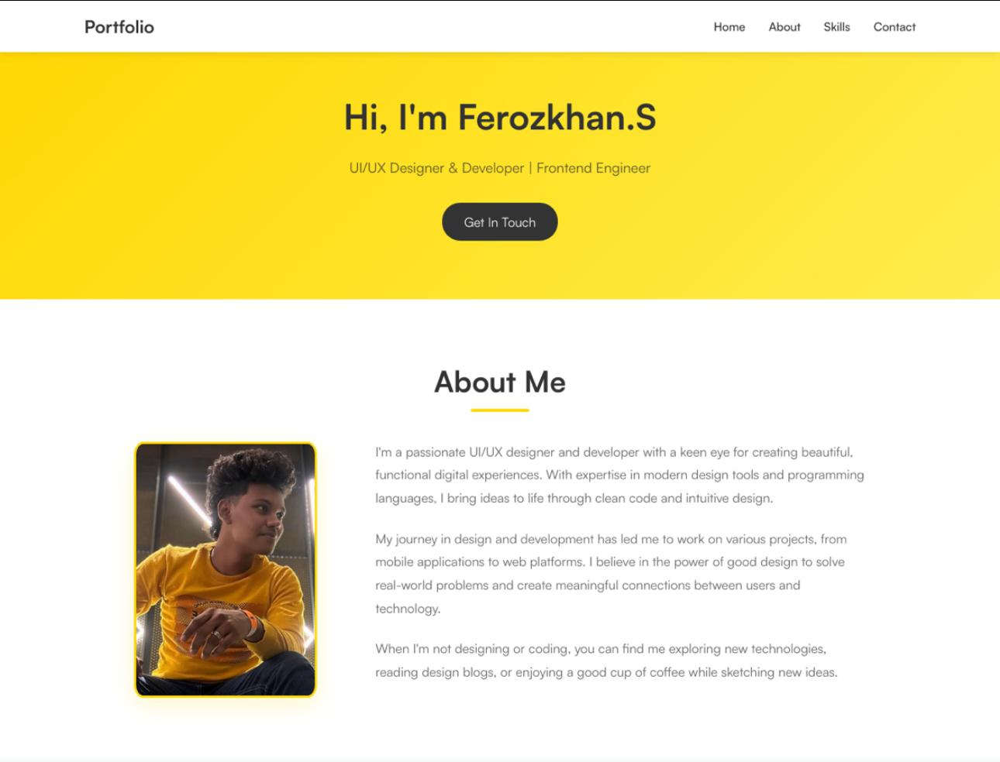

Slide 12
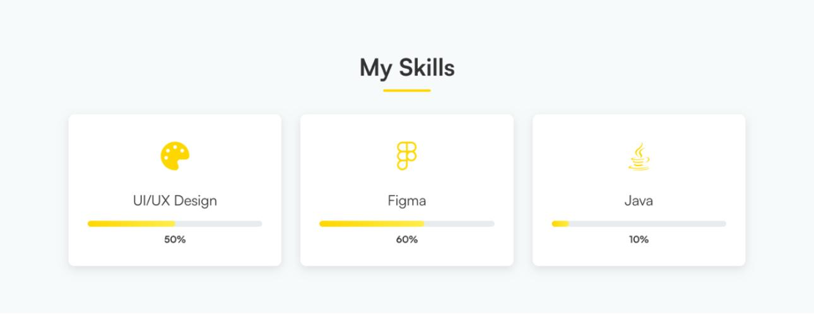

Slide 13
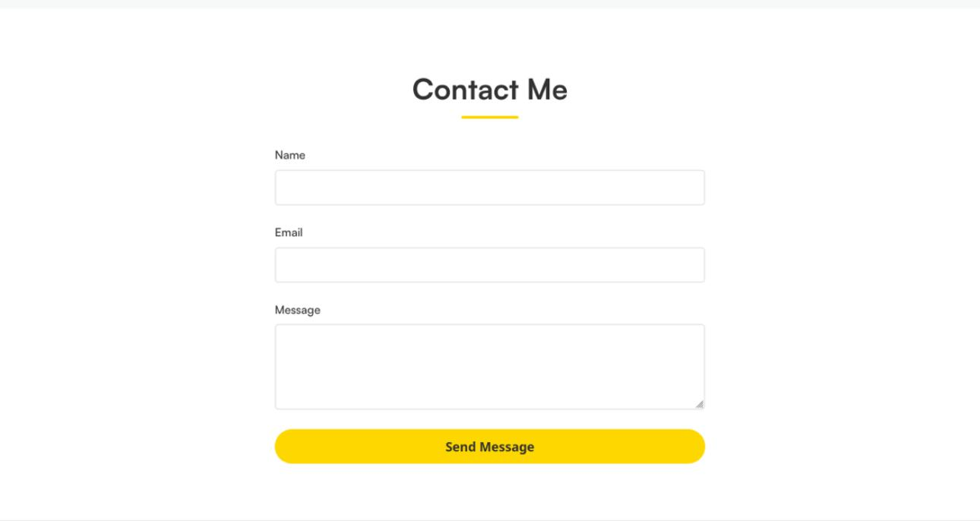

Slide 14
CONCLUSION
Building A Personal Portfolio In VS Code Using Widely Accepted Web Technologies Offers Beginner Developers Like Feroz A Foundational Yet Impactful Way To Showcase Abilities, Achievements, And Facilitate Professional Networking. The Design's Simplicity, Skill Visualization, And Structured Sections Support Both Self-promotion And Further Personal Development.

Slide 15
GITHUB LINK
https://ferozk14.github.io/My_Portfolio/

